Slide 1
Welcome!

Slide 2
Automated Barriers and Lights
Presented by:
Ankit Kumar Pandit
Aloke Kumar Singh
Shalu Sharma
Shashi Chandra

Slide 3
The meaning:
As the name suggests it is completely an automated system and works autonomously .
The barriers come up and go down by themselves and so does the lights.
No need of external handling is required.

Slide 4
Why do we need it…?
The barrier:
As always to solve the same issue we had, have and will have , “survival”
and saving lives.
We all know the no. of accidents is increasing over time .
The injuries due to people falling can be fatal.

Slide 5
Why do we need it…?
The lights:
Its also about saving but this time its about energy .
Energy that is quantifiable or limited.
As we know to light up tunnels and metro routes all the time requires
continuous supplies
And huge amount of energy when there is traversing going on or not .
Huge amounts are wasted .

Slide 6
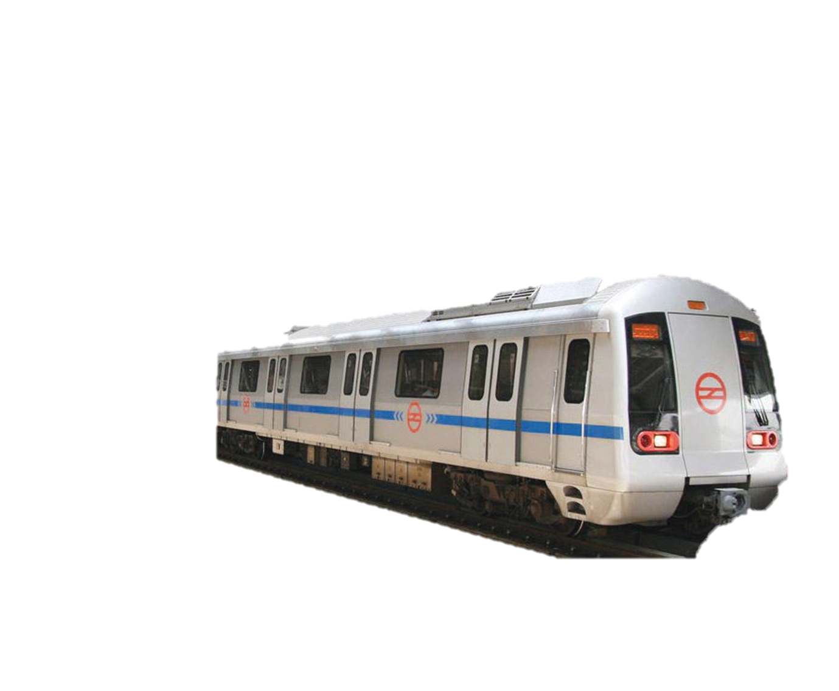

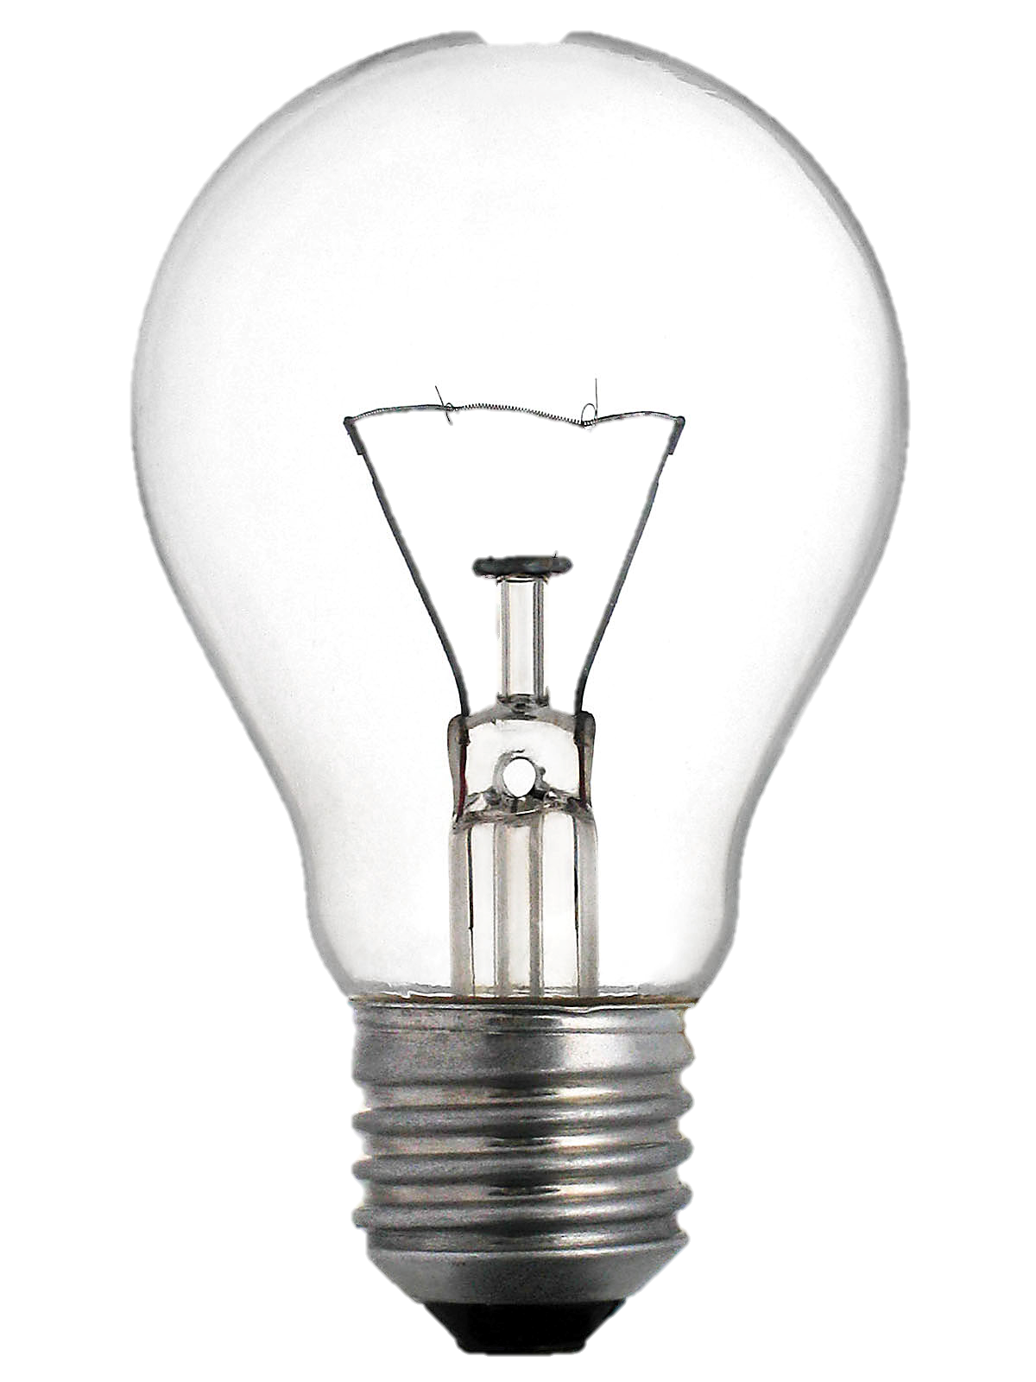
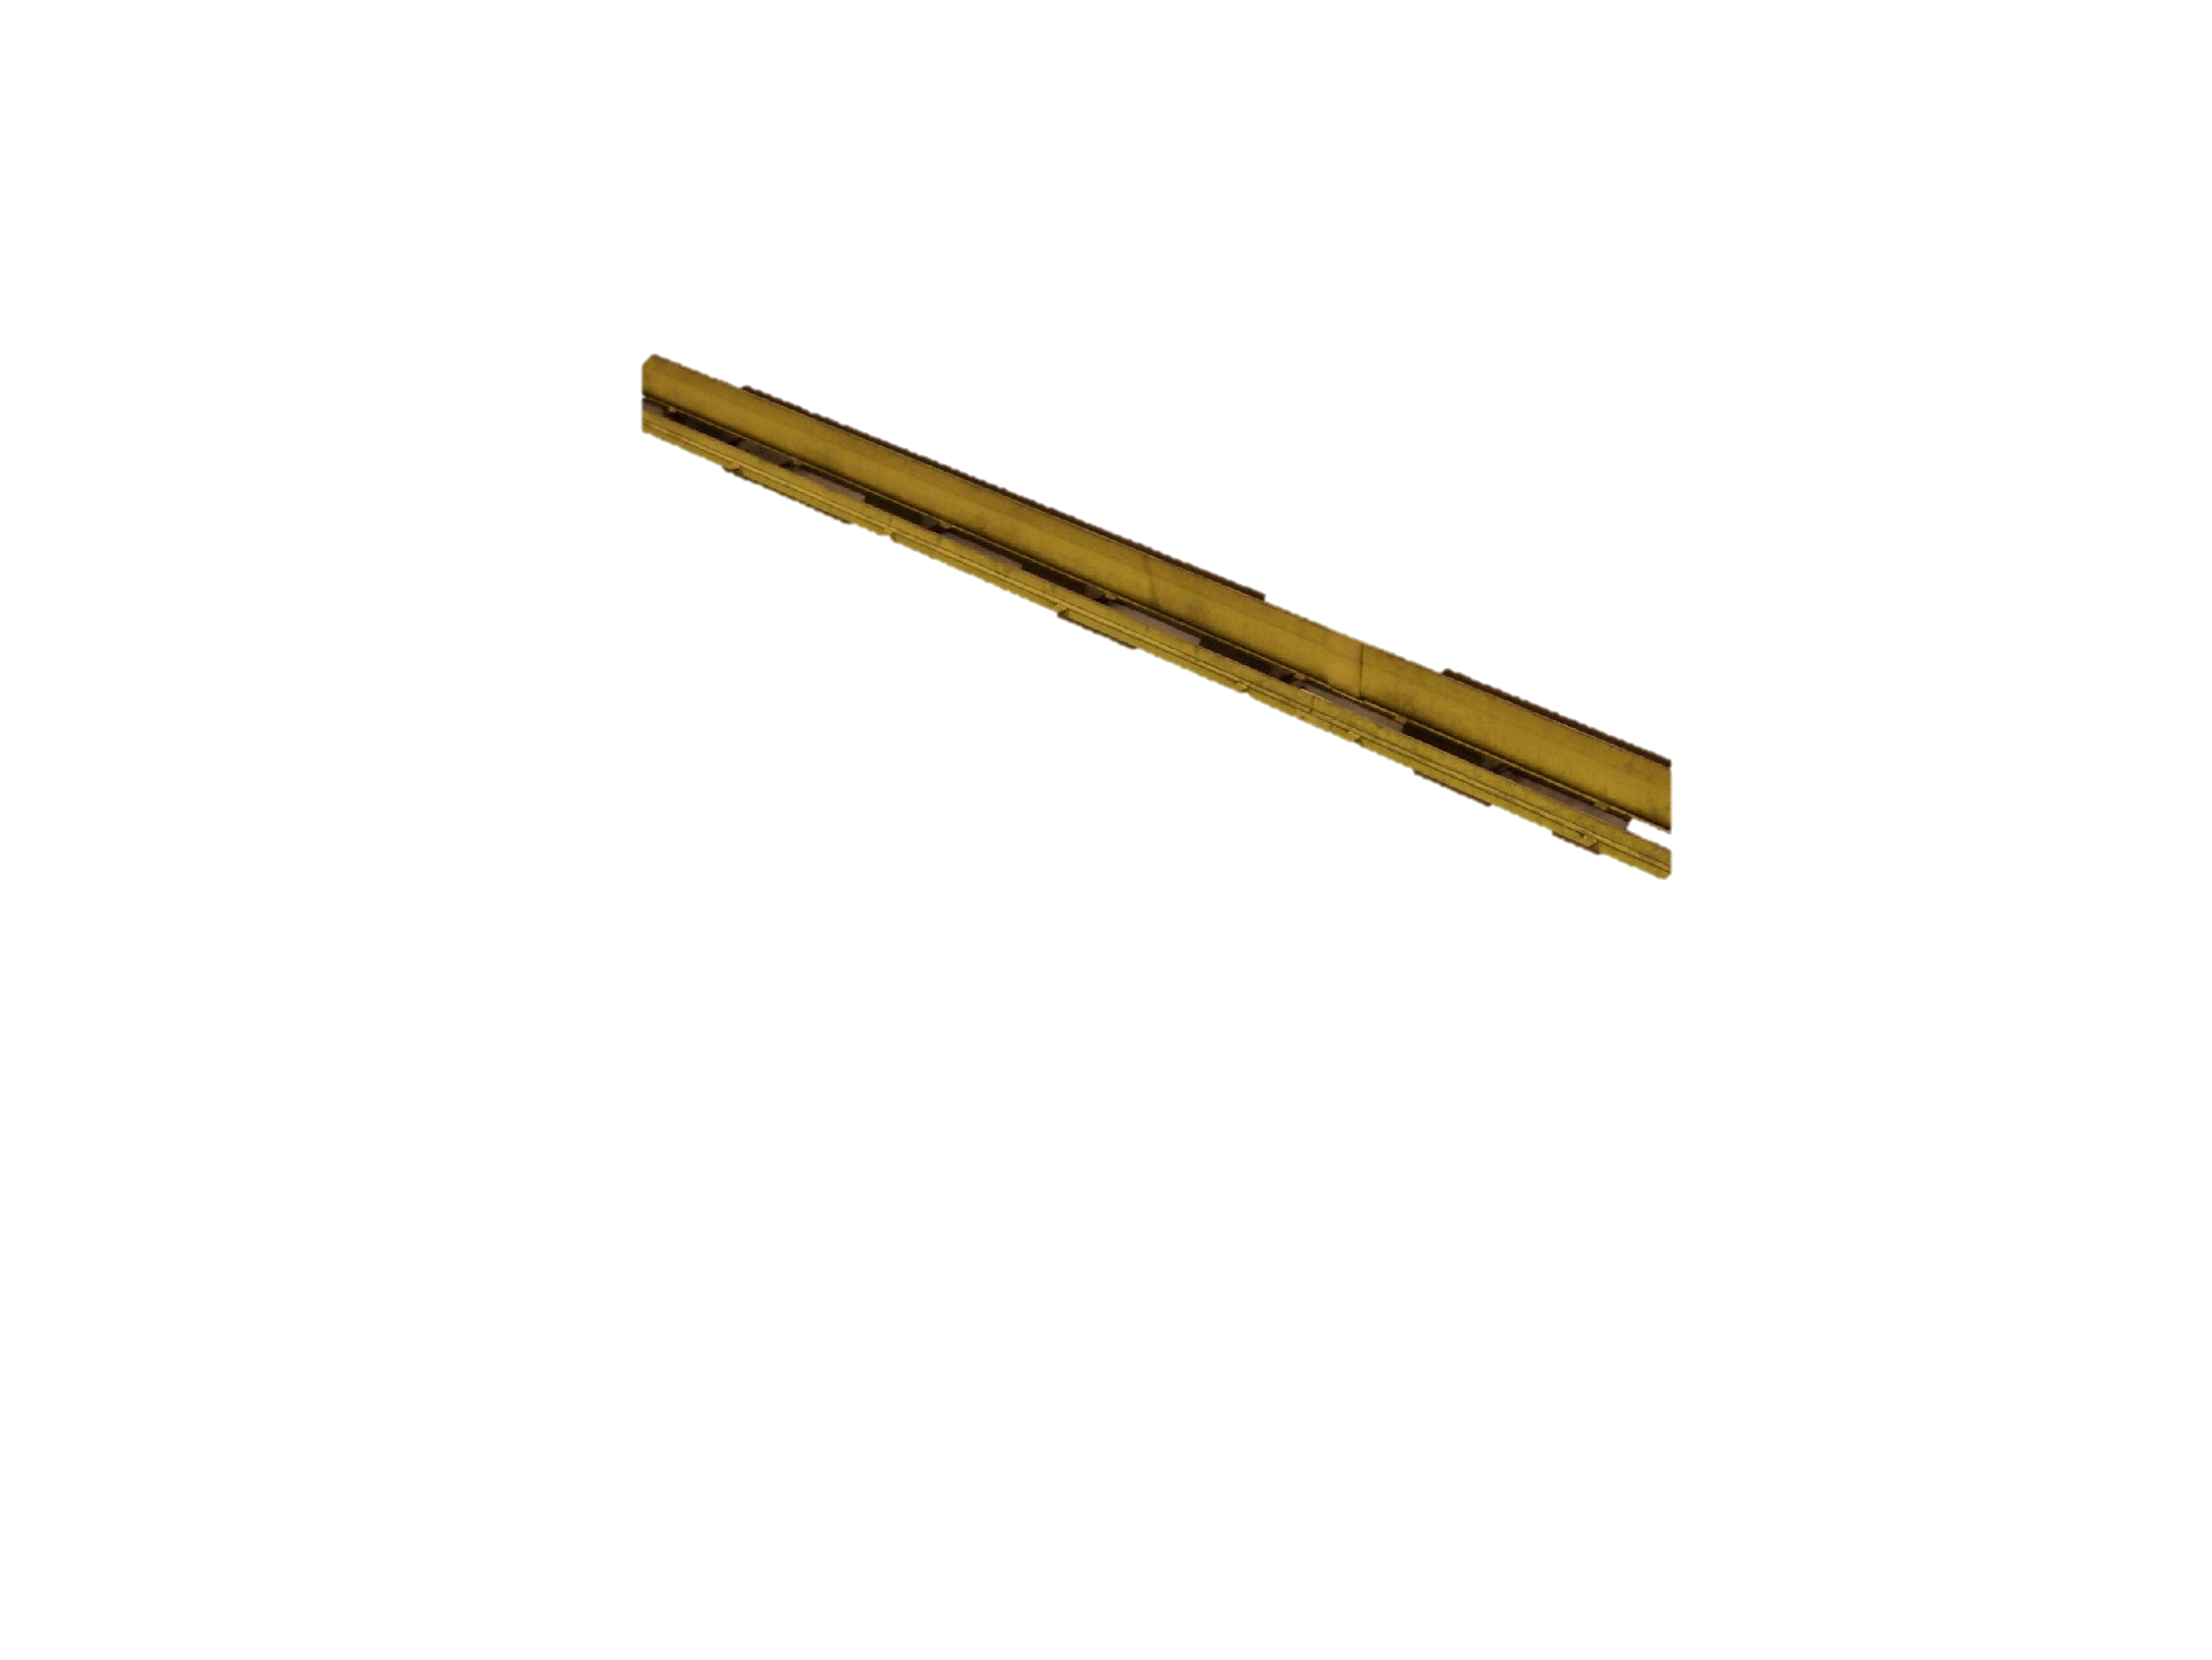
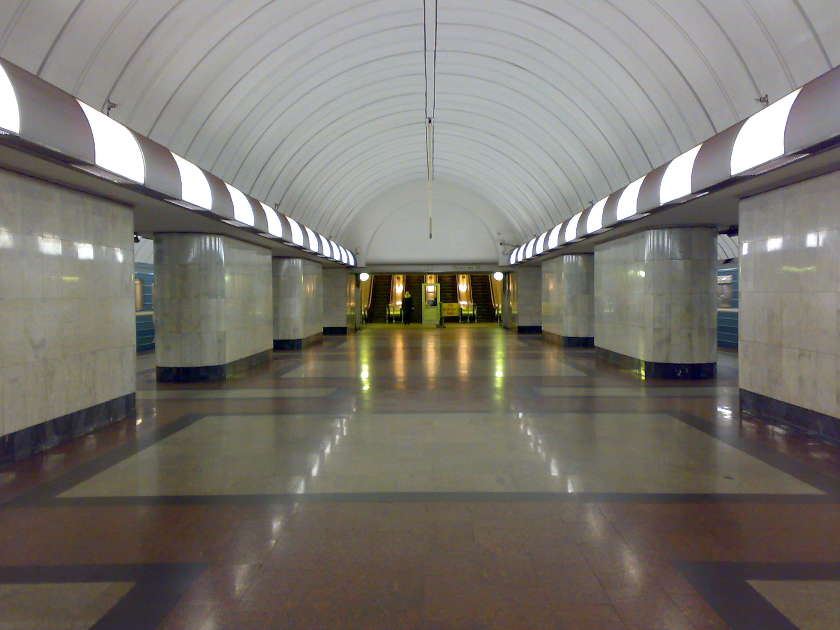
Working:
Initially no locomotives are there so no bulbs are on.

Slide 7
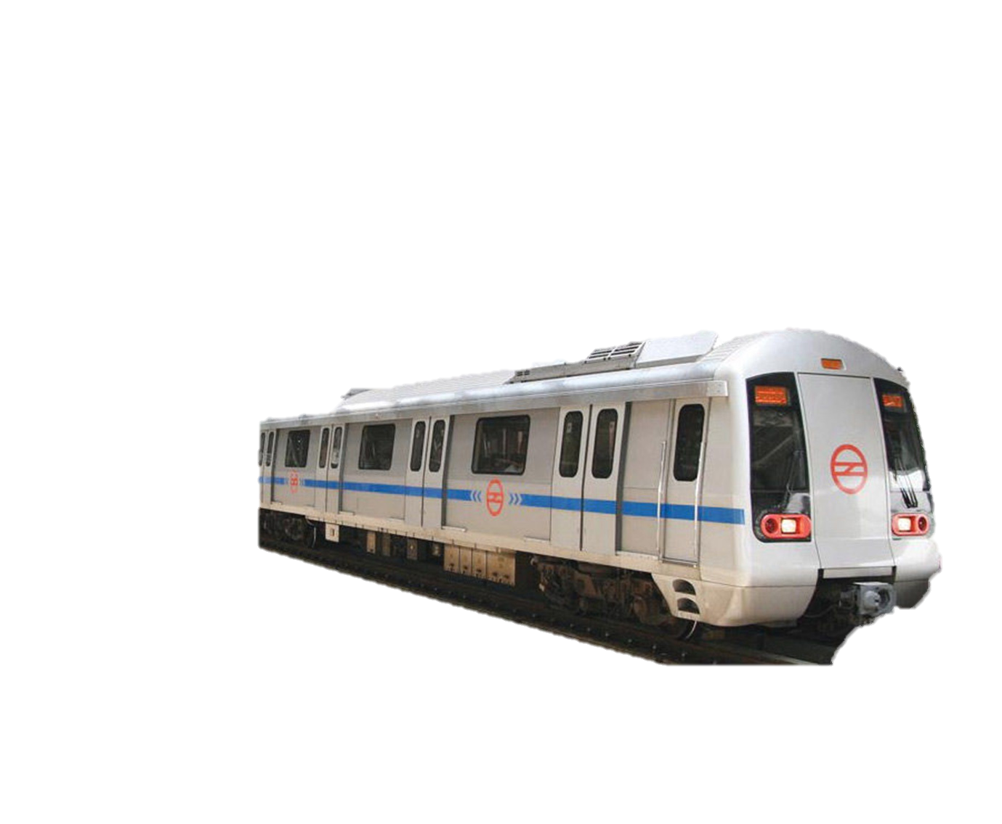
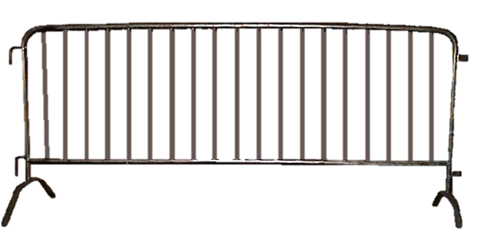

Working:
Initially no locomotives are there so barricades are there so that no one
falls down or any wrong happens but later as you know barricades comes up on their arrival and it it goes back after departures.

Slide 8
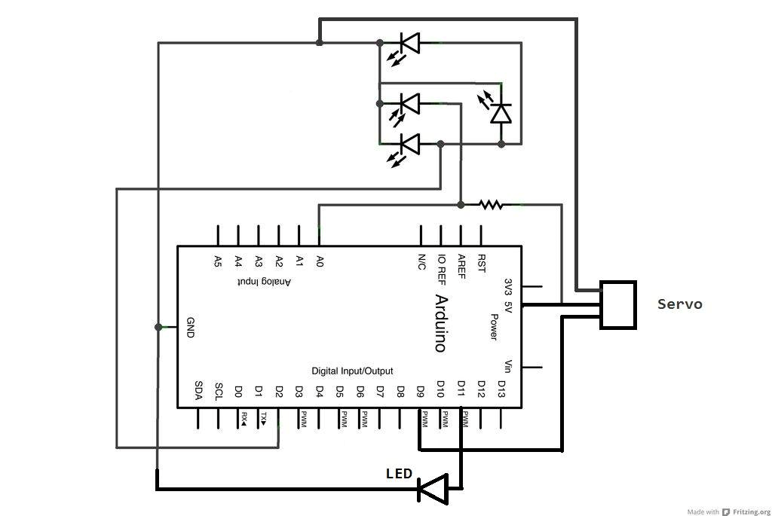
The circuit:

Slide 9
The working:
The circuit consists of a infrared sensor that senses the presence of an object around it and sends the signal to the Arduino in analogue form.
Arduino after receiving signal accordingly rotates the servo which controls the barriers.
The barriers open when the sensor is active, i.e. the train is on the station, and closes when the sensor is inactive i.e the train is not on trhe station.

Slide 10
Thank YOU !!!

